Slide 1


Stroke free?
Stress free.
Save Yourself
By: Jaskirat, Jelena, Nicole & Yumai (Team 5)

Slide 2




Agenda
Q1: jlkljlakjdd Mini - hypothesis
Resource Visualization
Main Hypothesis
Name Data Cleaning
Name Introduction
Conclusion
Project 3:
Team 5
Name Visualization Libs
Name Statistics
Q2: jdsdhsadlj Mini - hypothesis
Resource Visualization
Q3: sjdljsajdlkajdlsajd Interactive

Slide 3
Introduction
Image
Background (stroke)
Data Set
Significance/Applicability

Slide 4
Q1: ..samd.sadljlkjlkejqwlkejwlkqjelwelkjq
Analysis Approach
Visualization
Hypothesis
Library
DV

Slide 5
Q1: ..Continued
Analysis Approach
Visualization
Hypothesis
Library
DV

Slide 6
Q2:How does the distribution of strokes vary across different work/residence types and marital statuses
Analysis Approach
Hypothesis:
Individuals working in high-stress environments, such as private and self-employed sectors, will have a higher incidence of strokes compared to those in less stressful jobs like government jobs or being unemployed.
Urban residents will have a higher proportion of strokes due to lifestyle factors and stress associated with urban living.
Marital status will influence stroke occurrence, with married individuals potentially experiencing higher stress levels related to family and financial responsibilities, leading to a higher incidence of strokes.
Libraries:
To conduct this analysis, we will use a combination of python libraries for data manipulation, visualization, and statistical analysis. Specifically we will use: Pandas (manipulation and cleaning), Seaborn and Matplotlib (visualizing the data), and Plotly (creating interactive heatmaps).

Slide 7
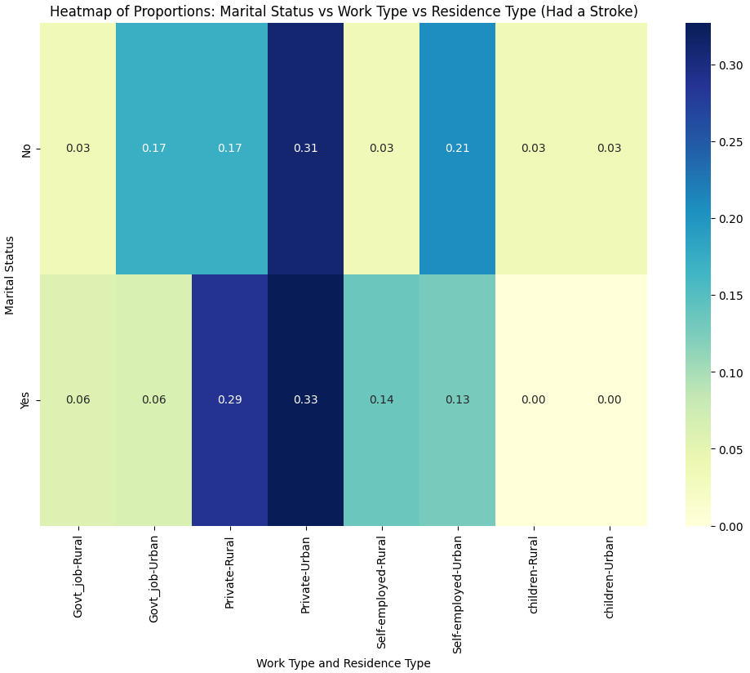
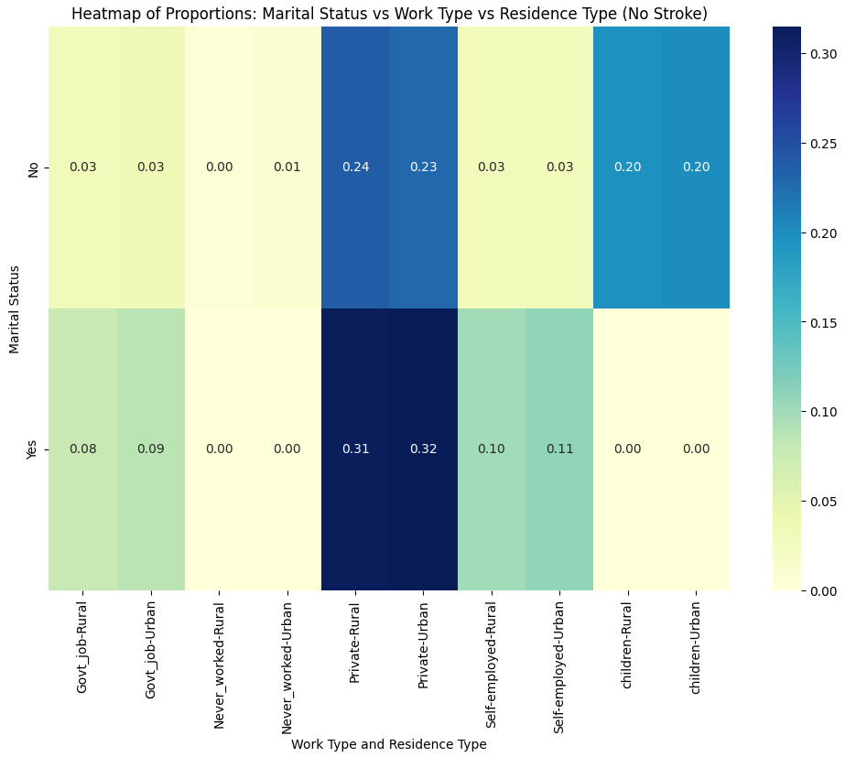
Q2: ..Continued
Visualization

Slide 8
Q3: ..samd.sadljlkjlkejqwlkejwlkqjelwelkjq
Analysis Approach
Visualization
Hypothesis
Library
DV

Slide 9
Q3: ..Continued
Analysis Approach
Visualization
Hypothesis
Library
DV

Slide 10
Discussion
+ Dashboard; demonstrate interactivity

Slide 11
conclusion
Future direction
Limitations
Group Review

Slide 12


Thank you

